Slide 1
University of Basrah
AL-Zahraa College of Medicine
Ministry of higher Education and Scientific Research
Cardiorespiratory Care Block
Lecture title: acute respiratory distress syndrome
Date: 9/2/2022
Dr. Mohammed adil
CRC Block Staff:
Dr Firas Rashid Sayil (block leader)
Dr. Mohammed Adil
Dr Assad Hassan
Dr Ahmed Qassim
Dr Safa Asaad
Dr Mustafa Ghazi
Dr Ilham Mohammed
Dr Zainab Muzahim
Dr. Ahmed Bader
Dr Nawal Mustafa
Dr Zainab Almnaseer
Dr Farqad Alhamdani
Dr Ban M. Saleh
Dr Amani Namaa
References as in the workbook and classroom.
For more detailed instruction, any question, cases need help please contact block leader at the CRC Google classroom or email.

Slide 2
University of Basra
AL-Zahraa College of Medicine
Ministry of higher Education and Scientific Research
Learning objective:
1- knowing the definition of ARDS
2- knowing the pathological stages of the disease
3-knowing the classification of ARDS according to severity
4- getting to understand the outline of treatment

Slide 3
University of Basra
AL-Zahraa College of Medicine
Ministry of higher Education and Scientific Research
Acute respiratory distress syndrome (ARDS) is a clinical syndrome of severe dyspnoea of rapid onset, hypoxemia and diffuse infiltrate that may lead to respiratory failure.

Slide 4
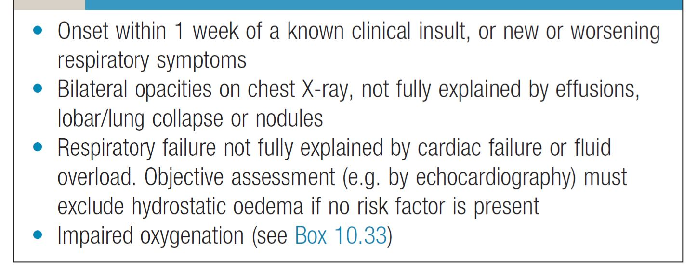
University of Basra
AL-Zahraa College of Medicine
Ministry of higher Education and Scientific Research
Berlin definition of ARDS

Slide 5
University of Basra
AL-Zahraa College of Medicine
Ministry of higher Education and Scientific Research
Aetiology:
There are many causes of ARDS including :
Sepsis
Pneumonia
Aspiration pneumonia
Snake bite
Trauma
Acute pancreatitis.
Multiple transfusion
Inhalation injury
The most common cause of ARDS are pneumonia and sepsis which causes about 40-50% of cases of ARDS

Slide 6
University of Basra
AL-Zahraa College of Medicine
Ministry of higher Education and Scientific Research
Classification of ARDS severity:
ARDS severity can be classified based on PaO2 and FiO2 ,commonly called P:F ratio:
Mild ARDS if PaO2/FiO2 in between 200-300.
Moderate ARDS if PaO2/FiO2 in between 200-100.
Severe ARDS if PaO2/FiO2 less than 100

Slide 7
University of Basra
AL-Zahraa College of Medicine
Ministry of higher Education and Scientific Research
Stages of ARDS:
1- The exudative stage of ARDS: there is an acute injury to alveolar capillary endothelial cells and type I pneumocytes.
This results in loss of the normal alveolar barrier with subsequent leakage of protein-rich fluid into the alveoli (noncardiogenic pulmonary oedema).
In the early phase, the inflammatory cell infiltrate is predominantly neutrophils. Pathologically, the finding is described as diffuse alveolar damage, Hyaline membranes and loss of type I pneumocytes are seen.
The exudative phase of ARDS lasts for approximately the first 7 days of illness.

Slide 8
University of Basra
AL-Zahraa College of Medicine
Ministry of higher Education and Scientific Research
2- The proliferative phase is second phase of ARDS , which begins around day 7 and continues through day 21.
Most patients recover during this phase and are able to be liberated from mechanical ventilation.
Histologically, early signs of repair can be seen in this phase with shift to a lymphocyte predominant infiltrate, proliferation of type II pneumocytes, and organization of the alveolar oedema

Slide 9
University of Basra
AL-Zahraa College of Medicine
Ministry of higher Education and Scientific Research
3- the fibrotic stage of the disease:
Only a few individuals who develop ARDS fail to recover during the proliferative phase and continue into the fibrotic stage of the disease.
Individuals who develop fibrotic ARDS demonstrate extensive alveolar and interstitial fibrosis at sites of prior alveolar oedema.
The acinar architecture frequently becomes distorted, leading to development ofemphysematous changes with large bullae.
Fibrotic proliferation may also occur in the intima of pulmonary vasculature, leading to development of pulmonary hypertension.

Slide 10
University of Basra
AL-Zahraa College of Medicine
Ministry of higher Education and Scientific Research
Diagnosis:
ARDS can be difficult to distinguish from fluid overload or cardiac failure.
ARDS is diagnosed in the presence of acute bilateral pulmonary infiltrates and hypoxemia without evidence of increased left atrial filling pressure.

Slide 11
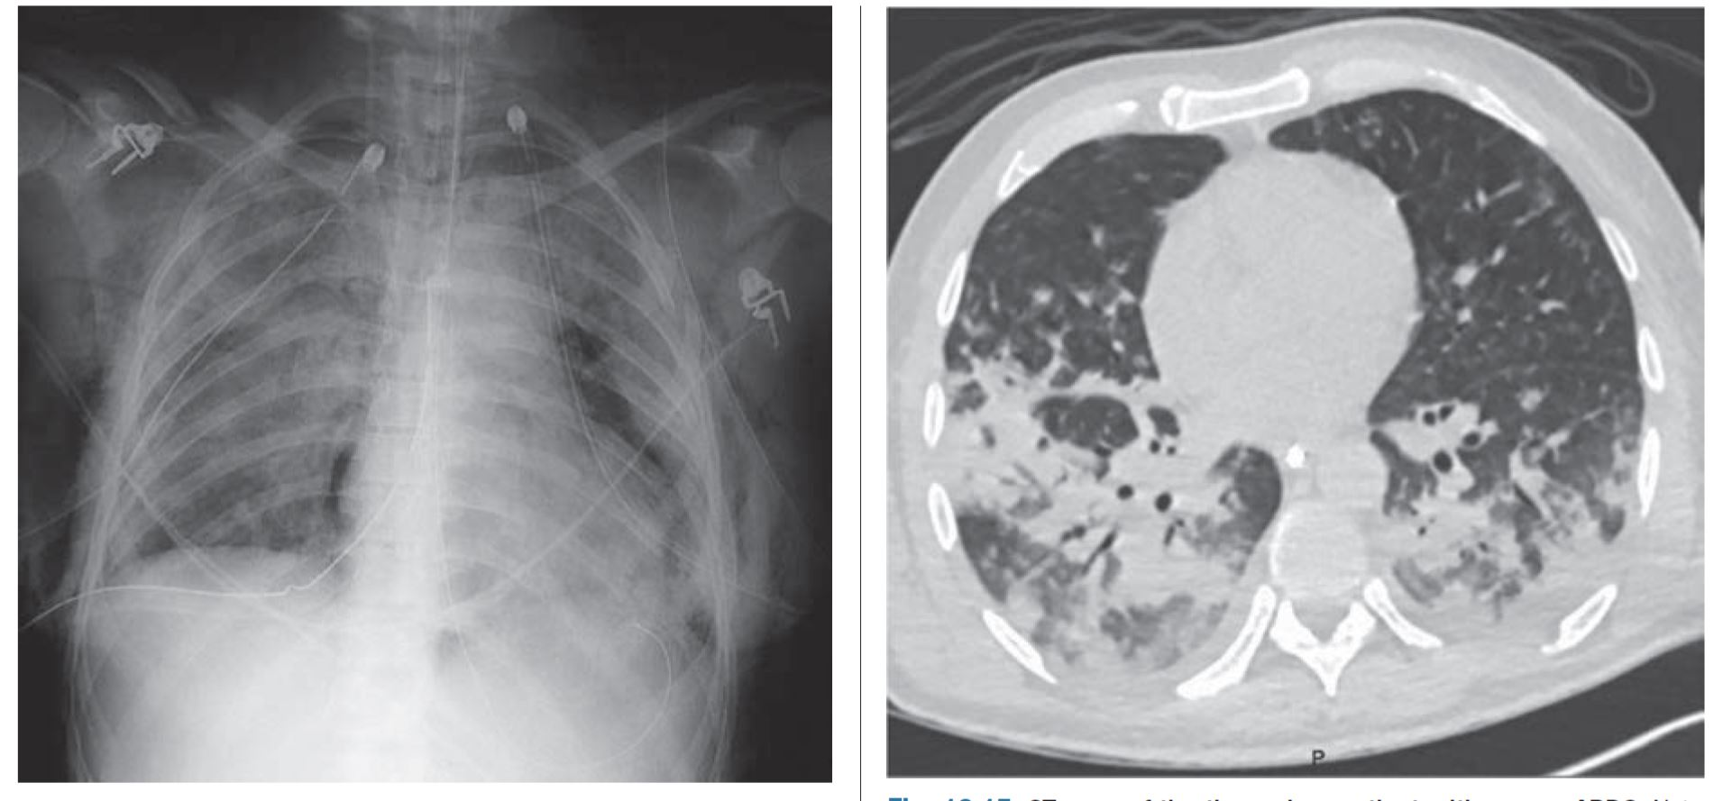
University of Basra
AL-Zahraa College of Medicine
Ministry of higher Education and Scientific Research

Slide 12
University of Basra
AL-Zahraa College of Medicine
Ministry of higher Education and Scientific Research
Management:
Management of ARDS is supportive, including use of lung-protective mechanical ventilation, inducing a negative fluid balance and treating the underlying cause.
Establishing the severity of ARDS is useful, as severe disease will require more proactive management such as prone positioning or extracorporeal membrane oxygenation.
the goal is to minimize overdistention of less affected areas of the lungs while maximizing alveolar recruitment. Positive end-expiratory pressure (PEEP) is used to prevent alveolar collapse at end-expiration.

Slide 13
University of Basra
AL-Zahraa College of Medicine
Ministry of higher Education and Scientific Research
Thank you

